Slide 1
Shell Bootcamp 2024 3 Reflections for Week #<>
Zainab Mujtaba
Date : 06-Sept-2024

Slide 2

About Me
"Learning never exhausts the mind, and as a fresher, it opens doors to endless possibilities."

Slide 3

My learnings from this week!

Slide 4

Learning 1 | My takeaways
GitHub Actions is a powerful tool for automating workflows and integrating Continuous Integration/Continuous Deployment (CI/CD) directly within GitHub repositories. Here are key learnings and insights from working with GitHub Actions:
CI/CD pipeline integration
Customizable workflows
Automation of repetitive tasks

Slide 5

Learning 2 | My takeaways
Scrum, as an Agile framework, emphasizes empirical process control, allowing teams to make decisions based on observation, experience, and data rather than predictions. It promotes iterative and incremental development, where work is divided into time-boxed sprints, delivering potentially shippable products at the end of each iteration. Teams in Scrum are cross-functional and self-organizing, enabling them to make decisions and adapt quickly to changes. Daily standups, or Scrum meetings, foster transparency and communication, helping teams stay aligned on goals.

Slide 6
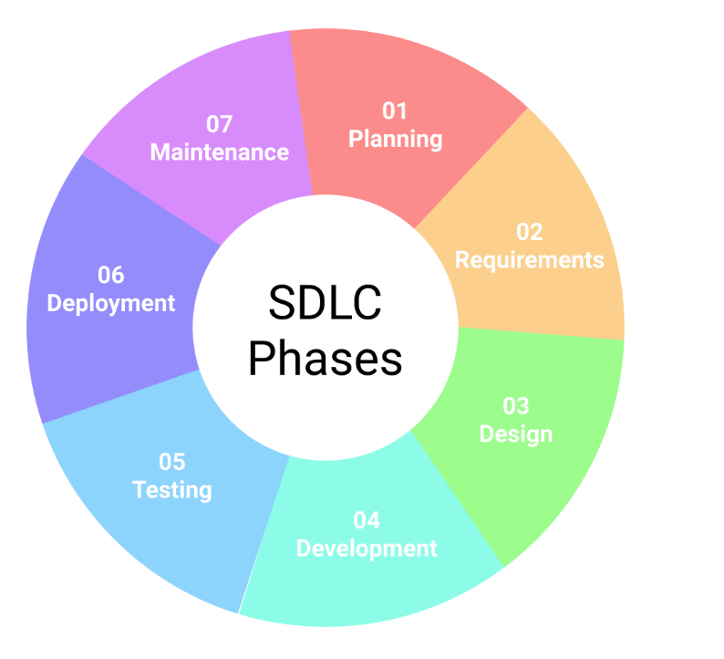
Learning 3 | My takeaways
The Software Development Life Cycle (SDLC) provides a structured approach to software development, guiding teams through key phases like planning, design, development, testing, and deployment. One of the core learnings is the importance of gathering and analyzing requirements early on, as this lays the foundation for the entire project. A well-designed architecture ensures scalability and maintainability, while phased development reduces risks by breaking down the process into manageable steps. Testing plays a crucial role in ensuring quality, while continuous feedback loops allow for iterative improvements. Documentation throughout the process ensures clarity and continuity, making future maintenance easier. Post-deployment, ongoing maintenance is essential to keep the software functional and relevant. Effective collaboration with stakeholders and proactive risk management are also crucial to the overall success of a project.

Slide 7

Relevance of learnings for my organization

Slide 8

Learning 1 | Relevance for Shell
GitHub Actions is highly relevant in the energy industry as it automates workflows for software development, deployment, and data processing. It enables continuous integration and deployment, which speeds up updates and ensures reliability in energy management systems. By automating tasks such as data pipeline management, security checks, and documentation, GitHub Actions improves efficiency, enhances collaboration, and supports scalable operations. Its integration capabilities and real-time monitoring also help maintain system performance and manage critical infrastructure effectively.

Slide 9

Learning 2 | Relevance for Shell
Scrum is highly relevant in the energy sector as it provides a framework for managing complex projects and adapting to changing requirements. In energy projects, Scrum helps teams collaborate more effectively, prioritize tasks, and deliver incremental improvements. Its iterative approach allows for regular reassessment of goals and adjustments based on stakeholder feedback, which is crucial in the dynamic and often regulated energy industry. Scrum's focus on continuous improvement and transparency aids in managing complex energy systems, developing new technologies, and responding to regulatory changes efficiently. By fostering cross-functional teamwork and delivering frequent, valuable increments, Scrum enhances project flexibility and success in the energy sector.

Slide 10
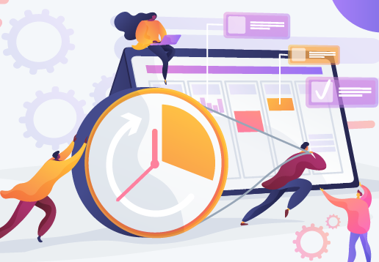
Learning 3 | Relevance for Shell
The Software Development Life Cycle (SDLC) is highly relevant in the energy sector as it provides a structured approach to developing, deploying, and maintaining software solutions essential for managing energy systems. SDLC ensures that complex projects, such as those involving energy management systems, grid monitoring, and data analysis, are executed systematically, reducing risks and improving quality. By following a phased approach—ranging from requirement gathering and design to development, testing, and maintenance—SDLC helps in delivering robust software that meets regulatory standards and operational needs. It also supports continuous improvements and updates, ensuring that energy systems remain efficient, secure, and capable of adapting to new technologies and regulatory requirements.

Slide 11

Challenges in implementing learning

Slide 12

Challenge faced while implementing Learning 1
Implementing GitHub can be challenging due to the learning curve associated with Git and its features, integration issues with existing tools, and security concerns around access control and sensitive information. Collaboration may be hindered by merge conflicts and inconsistent practices, while performance issues can arise with large repositories. Change management is needed to overcome resistance and adjust workflows, and cost considerations are important for private repositories and enterprise features. Addressing these challenges requires careful planning, training, and support.

Slide 13
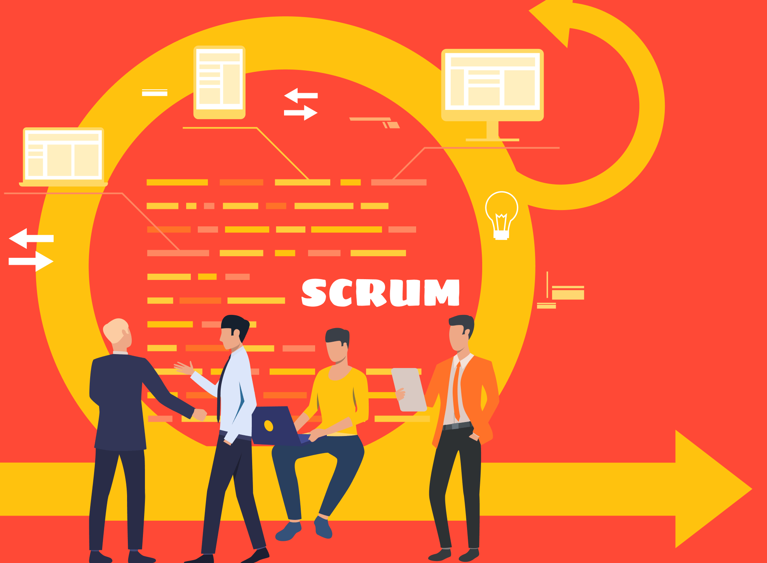
Challenge faced while implementing Learning 2
Challenges with using Scrum include resistance to change, defining clear roles, ensuring effective communication and collaboration, managing scope creep, and maintaining team dynamics. Time management for Scrum events, product backlog prioritization, and scaling Scrum for large projects can also be difficult. Overcoming these challenges requires clear communication, ongoing training, and adapting Scrum practices to fit team and project needs.

Slide 14

Challenge faced while implementing Learning 3
Implementing the Software Development Life Cycle (SDLC) can present several challenges:
Requirement Gathering: Accurately capturing and defining requirements can be difficult and may lead to scope changes.
Project Management: Balancing time, cost, and resources while adhering to the SDLC phases can be complex.
Documentation: Maintaining comprehensive and up-to-date documentation can be time-consuming and may be neglected.

Slide 15

Learning is also Fun!

Slide 16

Learning is also Fun!
We participated in a number of team oriented activities which helped us understand how we are better when we are together.
We indulged in a number of different warming u exercises as well which helped in keeping the morale up.

Slide 17

Summary
1. Implementation Challenges: All three frameworks—GitHub, Scrum, and SDLC—face difficulties with integrating new practices and tools, managing scope and requirements, and ensuring effective collaboration and documentation.
2. Adaptation and Management: Overcoming resistance to change, maintaining role clarity, and adapting processes to fit team needs are common challenges in implementing these methodologies.
3. Performance and Quality: Ensuring system performance, quality assurance, and managing costs are critical issues across GitHub, Scrum, and SDLC, requiring careful planning and ongoing adjustments.

Slide 18
Thank You

